Slide 1
IoT Based Smart Security and Home Automation
NAVEEN KUMAR K – 202IT178
MOHAMED FARHUN M – 202IT168
RAAHUL P S – 202IT196
LENIN PRAKASH RAJAN M – 202IT161

Slide 2
Abstract
Internet of Things is a system where appliances are embedded with software, sensors and actuators. The devices are able to transfer data over a network and also communicate with each other. This technique is incorporated in our house to make the appliances convenient and automated. This project focuses on building a home security system which will be wireless. Security over a network is achieved using AES encryption. Security of house is managed by sending notifications to the user using Internet in case of any trespasser and it can also ring an alarm if required. Home automation is utilized by using appropriate sensors installed around house. Raspberry pi is used as a server and controller. Raspberry pi has task of controlling electrical appliances and providing authentication and security to user.

Slide 3
Problem Statement Addressed
Today, there is an increasing demand of automated systems so that human intervention is reduced.
This paper focuses on a system that provides features of Home Automation relying on Internet of Things to operate easily, in addition to that it includes a camera module and provides home security. The android app basically converts Smartphone into a remote for all home appliances. Security is achieved with motion sensors if movement is sensed at the entrance of the house; a notification is sent that contains a photo of house entrance in real time. This notification will be received by the owner of the house via internet such that app can trigger a notification. So owner can raise an alarm in case of any intrusion or he/she can toggle the appliances like opening the door if the person is a guest

Slide 4
Existing Solution to the Problem Addressed
As per our survey, there exist many systems that can control home appliances using Android based phones/tablets. Each system has its unique features. Work on designing home automation system model is an ongoing process. Some models that have been developed already are discussed below.
Andrea Zanella explained the model of comprehensive survey of enabling technologies, protocols and architecture for an urban IOT . They explained various technical solutions and best-practice guidelines adopted in the Padova Smart City project, a proof of concept deploymenst of an IoT in the city of Padova, Italy, performed in collaboration with the city municipality.
Pavithra.D explained the model for efficient implementation of IoT in monitoring and controlling the home appliances via world wide web. This model is economical and scalable. The model provided control of appliances via a web server as well as locally without internet access.
Ravi Kishore Kodali, Vishal Jain, Suvadeep Bose and Lakshmi Boppana explained the model for IoT project which focuses on building a smart wireless home security system which sends alerts to the owner by using Internet in case of any trespass and raises an alarm optionally. The microcontroller used in the current prototype is the TICC3200 Launchpad board. This system can send alerts and the status sent by the wifi connected microcontroller managed system can be received by the user on his phone from any distance irrespective of whether his mobile phone is connected to the internet .

Slide 5
Proposed Solution to the Problem Addressed
There is an increasing demand of automated systems so that human intervention is reduced. This paper focuses on a system that provides features of Home Automation relying on Internet of Things to operate easily, in addition to that it includes a camera module and provides home security. The android app basically converts Smartphone into a remote for all home appliances. Security is achieved with motion sensors if movement is sensed at the entrance of the house; a notification is sent that contains a photo of house entrance in real time. This notification will be received by the owner of the house via internet such that app can trigger a notification. So owner can raise an alarm in case of any intrusion or he/she can toggle the appliances like opening the door if the person is a guest. The user can make use of this system to control switching on of lights, fan, AC, etc. automatically. We have also incorporated a smoke sensor which, on detection of smoke will ring an alarm and alert the user on their phone by SMS alert.

Slide 6
Proposed Solution to the Problem Addressed
The user can access complete IoT system from anywhere using Internet. But the micro-controller must always have Internet connectivity.Raspberry Pi is a small sized computer which acts as a server for the system. The Raspberry Pi system functions like a computer with a small setup. It contains GPIO pins and USB ports and also supports port for camera module. These pins can be toggled on/off using simple programs. The project mainly aims to overcome the shortcomings of home security systems by providing information of current situation when the owner is away from the house. It will also enhance the IoTs' network security using encryption and decryption of the user's data.

Slide 7
Proposed Solution to the Problem Addressed
At first the client signs in to our android application by entering default accreditations. There is office for administrator admittance to add/eliminate clients and change the default username and secret key. AES encryption is utilized in the application to give organization security. An attachment runs at server (Raspberry Pi) ,which is open continually and hangs tight for demand from client. Whenever client taps on login a client attachment is made in android application and association starts between Raspberry Pi and the android gadget. The encoded information is gone through this attachment to Raspberry Pi. At Raspberry Pi side unscrambling of the information happens. This unscrambled information is checked with the sections present in Raspberry Pi memory itself. On the off chance that right subtleties are given a reaction is sent back to gadget what begins another action. This new movement can then be utilized to control any home apparatuses with a straightforward on/off button UI. The solicitations are dealt with at server side by Raspberry Pi.

Slide 8
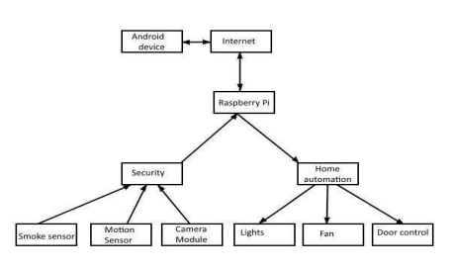
System Architecture

Slide 9
Work plan
Initially the user logs in to our android app by entering default credentials. There is facility for admin access to add/remove users and change the default username and password. AES encryption is employed in the app to provide network security. A socket runs at server (Raspberry Pi) ,which is open constantly and waits for request from user. When user clicks on login a client socket is created in android app and connection begins between Raspberry Pi and the android device. The encrypted data is passed through this socket to Raspberry Pi. At Raspberry Pi side decryption of the data takes place. This decrypted data is verified with the entries present in Raspberry Pi memory itself. If correct details are provided a response is sent back to device which starts a new activity. This new activity can then be used to control any home appliances with a simple on/off button UI. The requests are handled at server side by Raspberry Pi.

Slide 10
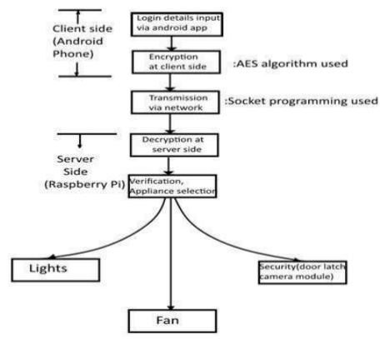
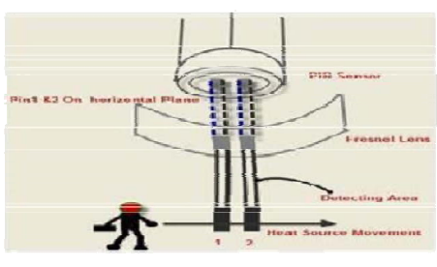
Block Diagram and/or Circuit Diagram

Slide 11
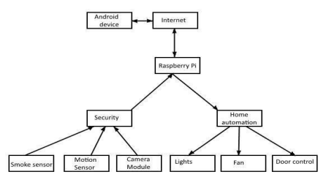
Flow Chart

Slide 12
Effective utilization of the Modern Tool & Cloud
A. Raspberry Pi A Raspberry Pi is a small -sized computer originally designed for portability, inspired by the 1981 BBC Micro. Eben Upton's created the device to make a small and affordable device to help improve programming skills and hardware understanding of students. Its small size and affordable price made it suitable for various applications. Hence it was quickly adopted by many customers. The Raspberry Pi is a complete Linux computer and provides all its functionalities at a low-power consumption level.
B. Sensors The PIR motion detection sensor can be used to detect any intruders at the door. It uses infrared rays to detect any movement. On detecting motion, the user is alerted and a picture is captured. MQ-2 module is useful for gas leakage detection . It can detect various dangerous fumes of gases like H2, LPG, CH4, CO, Alcohol, Smoke or Propane. For detecting temperature and humidity of home, there are various sensors but, among them DHT22 digital sensor is precise and gives an accurate reading. A camera is attached at home for surveillance activity and for security purpose.

Slide 13
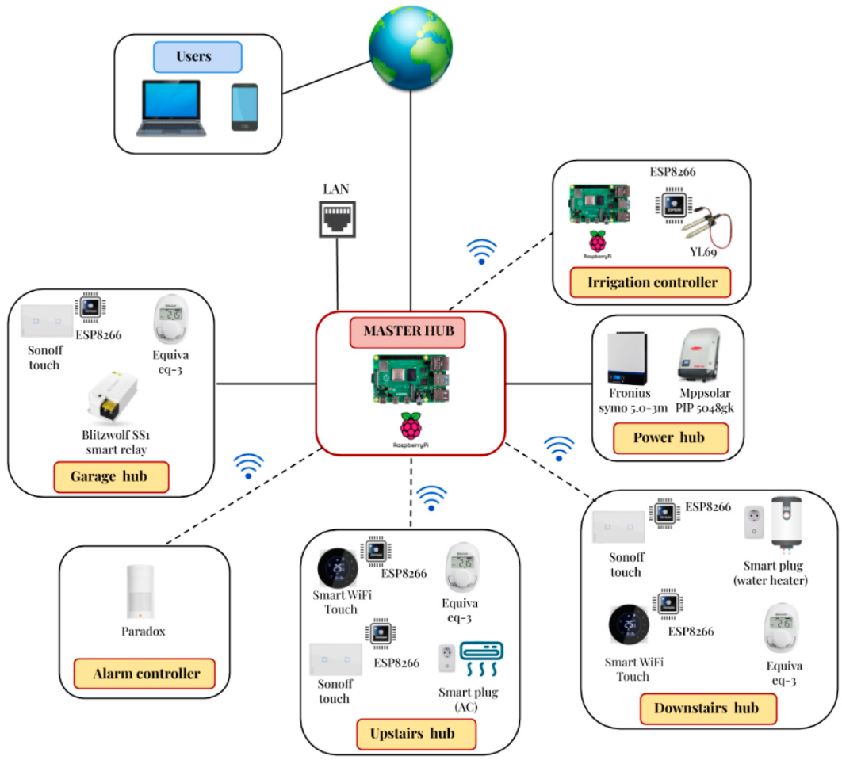
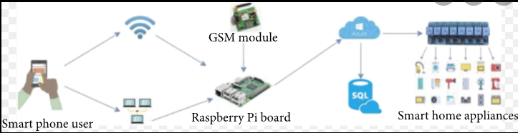
Technology stack & use case

Slide 14
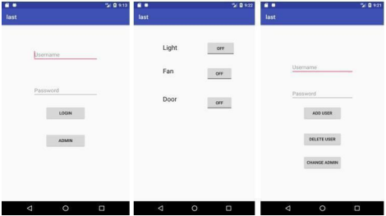
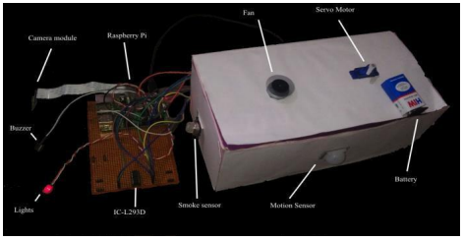
Prototype & Sample Output

Slide 15
Analysis of Results & Discussions
The prime objective of our project is to use an android smart phone to control the home appliances conveniently and to provide robust home security and safety measures. In future, the system can be improved by integrating the voice call feature within the same smart phone application through which the user can control his home appliances. Login can likewise be finished with various forthcoming advancements like retina/unique mark checking. This system would use a trusted face database to determine whether an intruder is detected or if it is a false alarm.

Slide 16
Cost Benefit Analysis (List of Components / Service Used)
S.No | Component Name | Specification (IC number or Range or Value) | Unit Cost | Total Cost
1. | Lights & Fans | - | Rs.150 | Rs.750
2. | Raspberry Pi | - | Rs.5000 | Rs.5000
3. | Electronic door latches | - | Rs.2000 | Rs.4000
4. | Security Camera and sensors | - | Rs.5000 | Rs.7000
5. | GSM Module | - | Rs.2000 | Rs.2000

Slide 17
References
[1] Ravi Kishore Kodali, Vishal Jain, Suvadeep Bose and Lakshmi Boppana, "IoT Based Smart Security and Home Automation System"
[2] Jasmeet Chhabra,Punit Gupta," IoT based Smart Home Design using Power and Security Management"
[3] Stan Kurkovsky, Chad Williams," Raspberry Pi as a Platform for the Internet of Things Projects: Experiences and Lessons ",2017 .
[4] Vamsikrishna Patchava, Hari Babu Kandala,P Ravi Babu,"A Smart Home Automation technique with Raspberry Pi using IoT",2015.
[5] B. R. Pavithra, D., “Iot based monitoring an control system for home automation,” 2015.
[6] Al-Ali, A.R. ; Dept. of Comput. Eng., American Univ., United Arab Emirates ; AL-Rousan, M., "Java-based home automation system"2004.
[7] Stefan Marksteiner, Víctor Juan Exposito Jimenez, Heribert Valiant, Herwig Zeiner, " Internet of Things Business Models, Users, and Networks", 2017 .
[8] S. Tanwar, P. Patel, K. Patel, S. Tyagi, N. Kumar, M. S. Obaidat, "An advance Internet of Things based Security Alert System for Smart Home"

